Slide 1
SPS Testbeam Analysis Status
Matt Hollingsworth

Slide 2
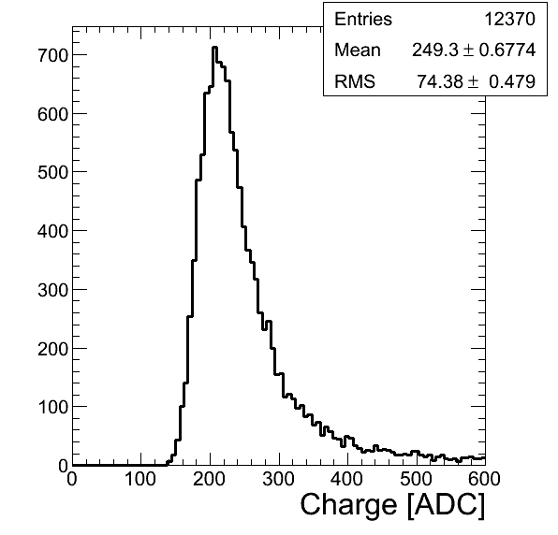
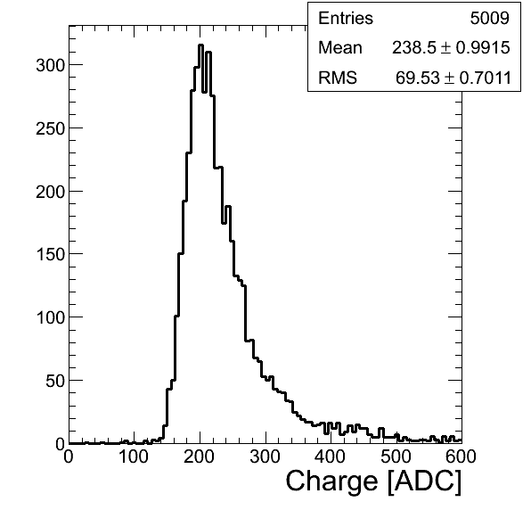
Strip Telescope Charge Deposit
Plane 0Y, 0 Tesla
Plane 0Y, 3 Tesla
Noise in strips is ~2.5 ADC channels, so 100 to 1 signal to noise ratio was achieved

Slide 3
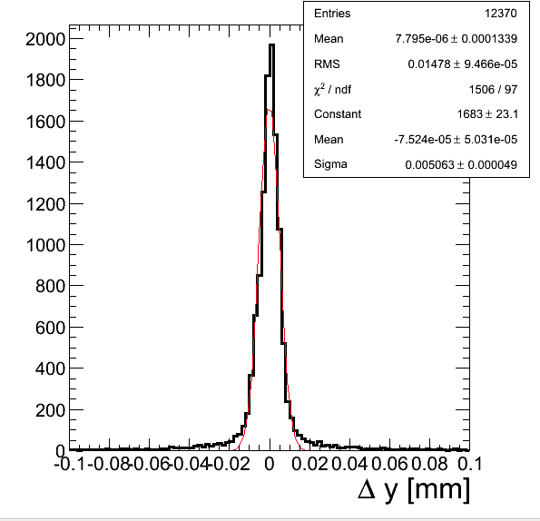
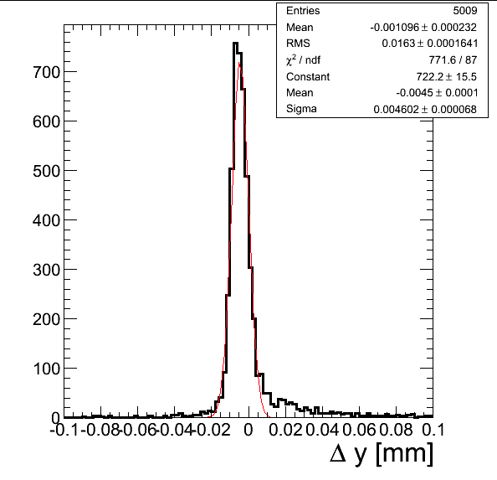
Single-plane Strip Telescope Residuals
Plane 0Y, 0 Tesla
Plane 0Y, 3 Tesla
Single-plane residuals (make track with 3 planes, find residual in 4th after alignment)
Shift in the mean at 3 Tesla is due to Lorentz smearing
Actual track residual is approximately this/2

Slide 4
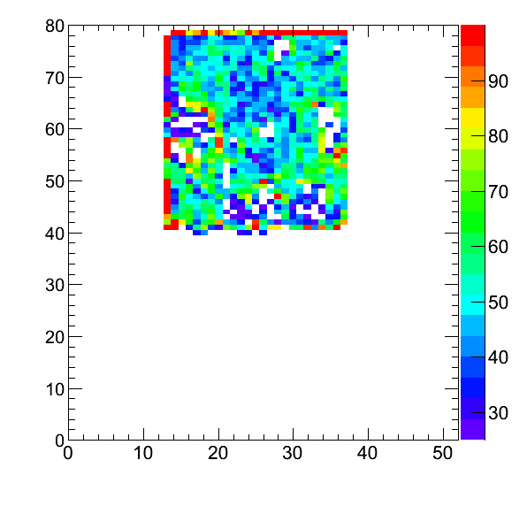
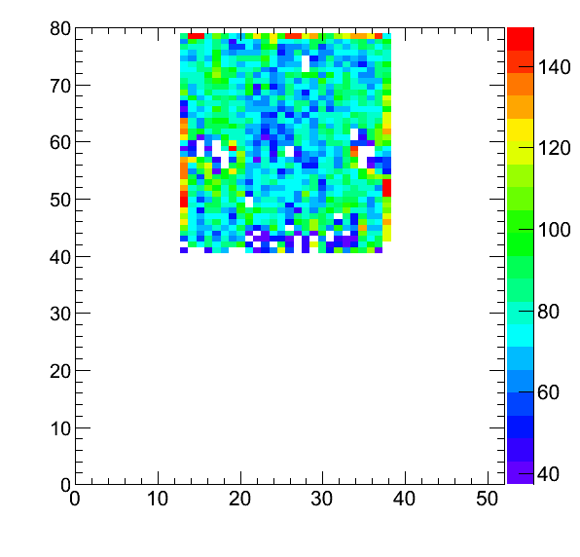
PLT Occupancy, Plane 2
0 Tesla
3 Tesla
Scale is such that red pixels are considered noisy and blank ones are dead
0 Tesla had significantly more dead/noisy pixels than did the B-field runs

Slide 5
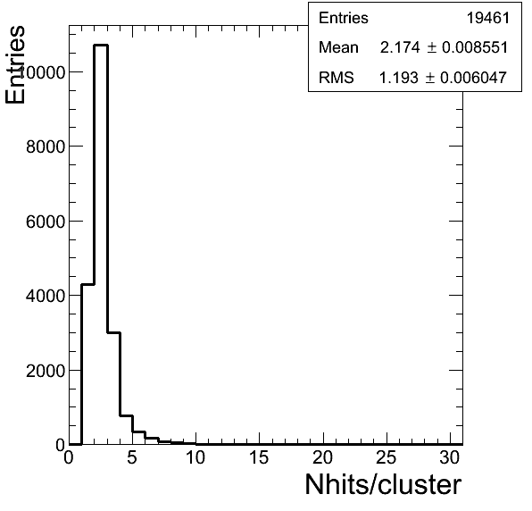
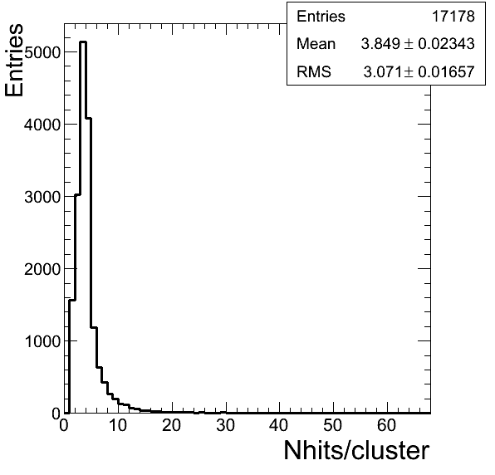
PLT Cluster Size
Increase in average cluster size due to Lorentz smearing in Y

Slide 6
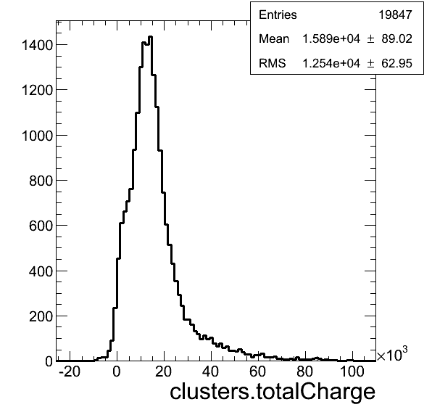
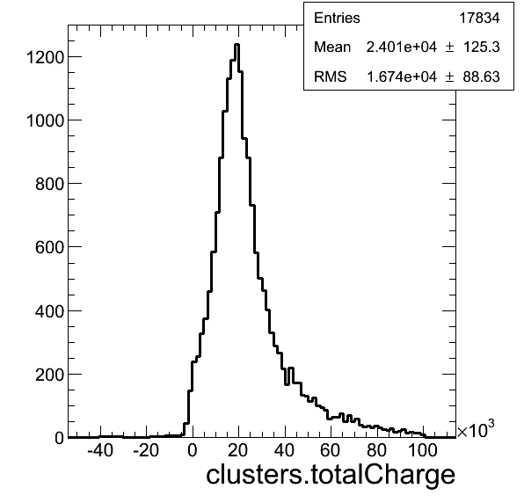
Charge Deposit
Expected Charge = 36/Cos(20 degrees)*500 um = 19100
Q < 0 sometimes?
No Trimming

Slide 7
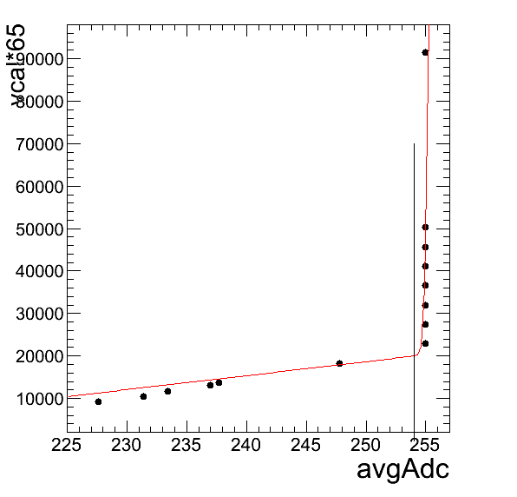
Gain Calibration
Line is drawn at where my fit determines the saturation point
Works very well when saturation is less sudden, but not so well in this ^ sort of situation where it saturates suddently
Picture is animated, shows lots of fits
Suggest: Storing a TGraph per pixel with all of the points from gaincal in it
Manageable for us (only a couple of megabytes per gaincal run) and will give us the most accurate results

Slide 8
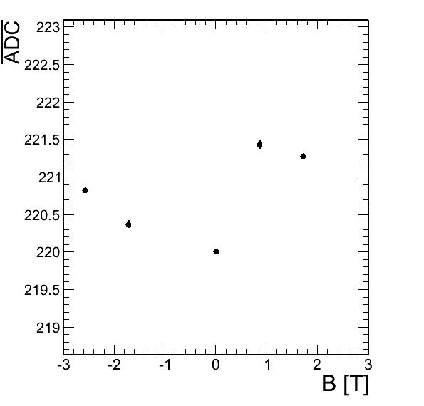
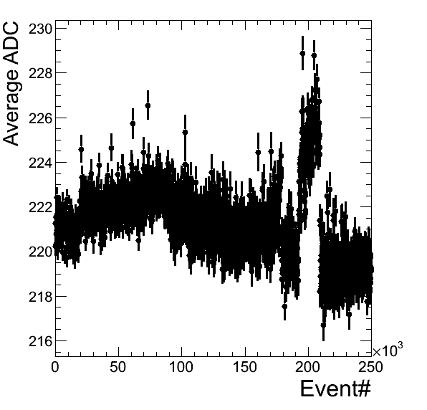
ADC Behavior
ADC instability can’t explain <0 charge

Slide 9
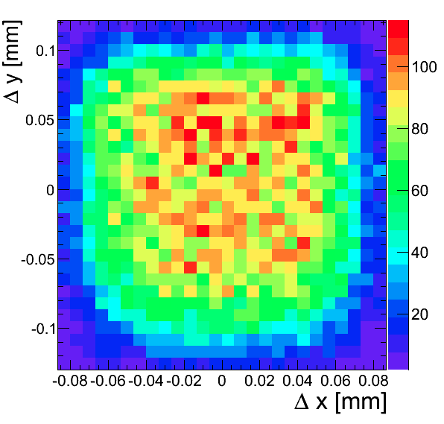
Pixel Radius of Sensitivity
For each hit, take the difference between pixel center and strip track position

Slide 10
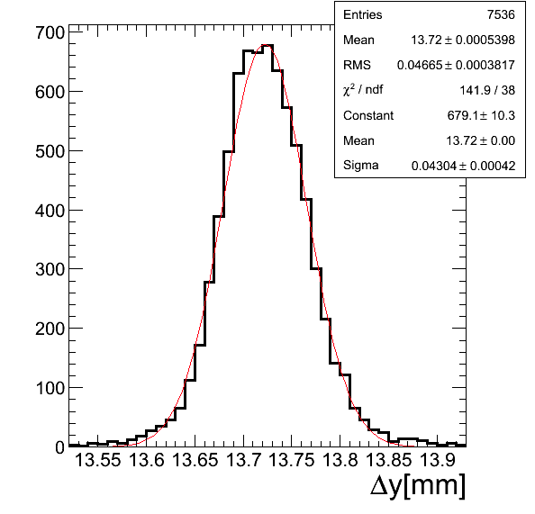
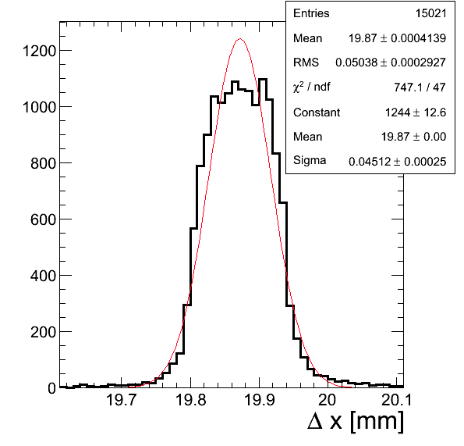
0T Residuals
Cuts: Remove noisy pixels, border rows/columns
Compensated for 20 degree rotation in Y
Cluster Topology: Dimension in Y, none in X
Require > 1 hits in both cases

Slide 11
Lorentz Angle Measurement
s₀
Without B
d
s₁
With B
s₁ = s₀ + d tanθ_{L}

Slide 12
Method
Measuring S
For each run, calculate mean difference between charge-weighted position in the PLT and strip track
Should shift in the direction of the smearing, so offset with respect to 0 B field determines the Lorentz Angle: ArcTan((s_{i} – s₀)/d)
Sources of Error
Main one is charge loss due to threshold effects
Makes PLT reconstructed position appear shorter for high B fields (resuling in a smaller ds -> smaller Lorentz Angle)
One hit events have much lower resolution

Slide 13
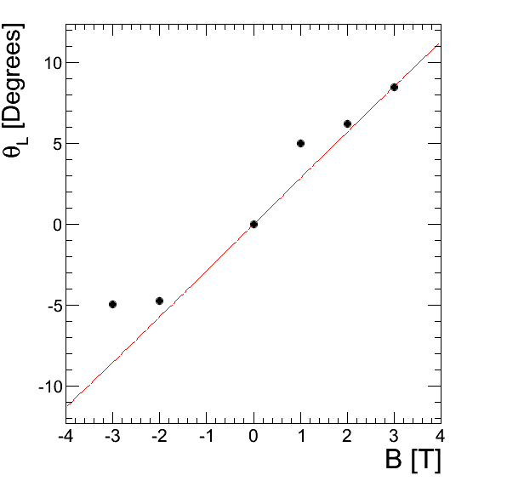
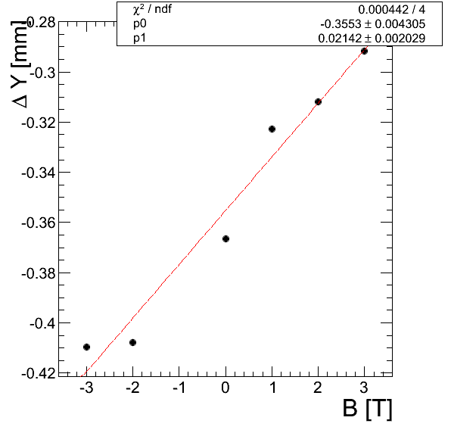
Current Result (in progress)
Red line is theoretical line, where I used the electron mobility of 0.05 m²/(Vs) as described in a paper by RD42
Dots are measured values using formula detailed on previous slide
This is a fit using the measured values; the slope over the diamond thickness is the mobility
Gives a mobility of 0.042 m²/(Vs)

Slide 14
Next Steps
Still refining the Lorentz Angle measurement, trying out different ways to correct for charge loss effects
Also working on figuring out the source of negative charge in the charge distributions

